Slide 1

Data cleaning for experimental data
EDUC 5913: Programming Fundamentals for Educational Research
Final project presentation
Jonathan Lee

Slide 2

Goal of the project
Clean the experimental data collected for further statistical analyses

Slide 3
Research questions of my experiments
Can naive listeners distinguish disfluency from other similarly sounding lexicon based on phonetic cues?
If so, what are the factors contributing to the individual differences in the foreign language learning performance?

Slide 4
Experiments
Perception ability
Phonological awareness to foreign language
Classification task (main study)
A total of 72 trials

Slide 5

Procedure of Exp.3
Native English speakers who have no prior exposure to French listened to naturalistic recordings of French sentences
Participants were asked to decide whether the first word of each recording was a lexical item (a word with lexical meaning; e.g., chair, apple, sun) or a filler (e.g., um, uh in English)
Example:

Slide 6
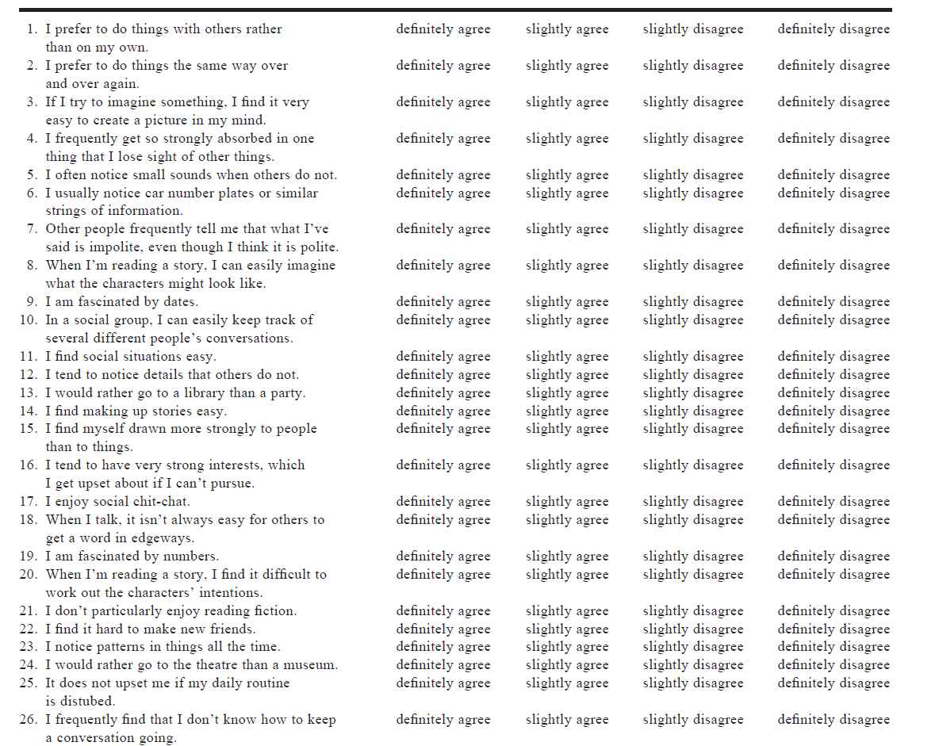
Potential factors
Gender
Monolingual or bi/multilingual
Personality traits (5 dimensions; 50 items)
Autistic traits (5 dimensions; 50 items)
General decision-making style (5 dimensions; 25 items)
Family size
Motivation

Slide 7
Data cleaning
Data files
Women: (118, 261)
Men: (94, 261)
Exclude illegible participants
Convert the behavioral responses to numerical format that can be analyzed
Restructure the measurement responses into different dimensions

Slide 8
Challenges and lessons learned
Overwhelmed by the amount of data
Be patient and calm
Planned the order of cleaning before coding
there can be cases of rule-ordering
Segregate the data cleaning procedure into different phases to reduce the task-switching costs
Code as I reference the formulae in each questionnaire vs.
Write out the conversion formulae of all questionnaires before coding

Slide 9
Challenges and lessons learned
Cross-checking at EVERY step
Very annoying (I was lazy at first)
Find some efficient ways
Check the heads and tails of the first and last column
See if the minimum and maximum values make sense
The art of coding starts beyond coding
Meaningful and organized naming in my experiment design
Facilitate grasping the feature patterns of variable names

